Slide 1
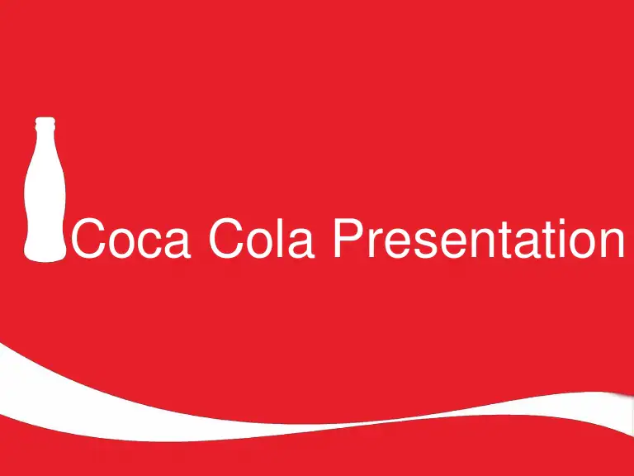

Slide 2
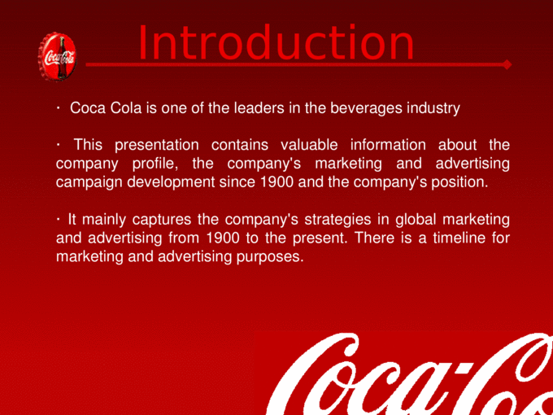

Slide 3
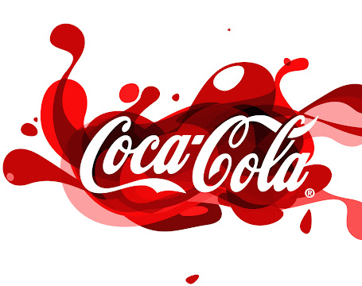
Current Trends
Gaming
Coffee
Inclusivity
Healthier Lifestyle

Slide 4
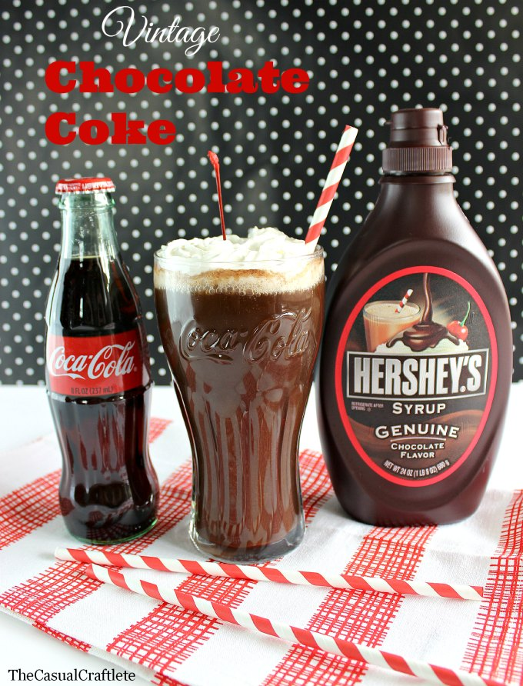
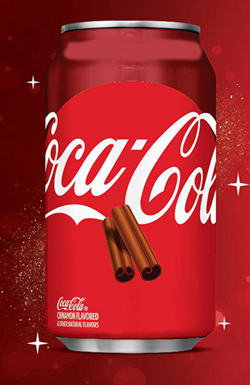
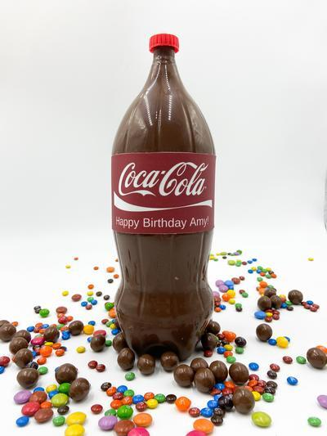
Chocolate Coca-Cola

Slide 5

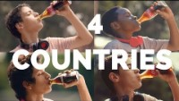
YouTube Ad

Slide 6
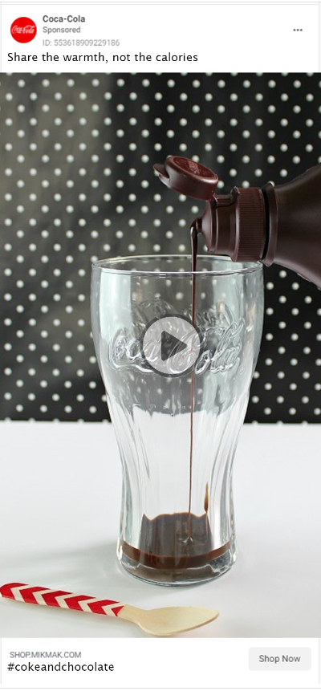


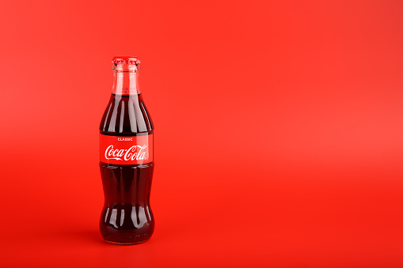

Slide 7

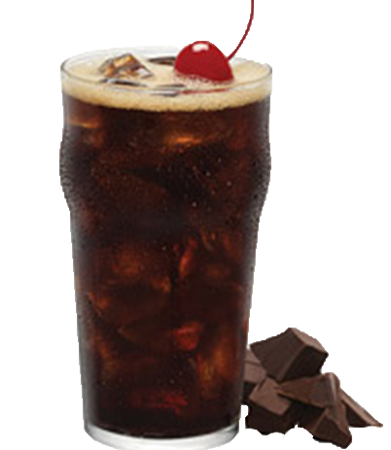
Twitter & Coca-Cola
Coke has 3 million Twitter followers
We will start sending out tweets two months before launch
These will include text and images
Our feeling is with the existing audience of millions of followers, we have a good opportunity for a favorable, and effective ROI

Slide 8
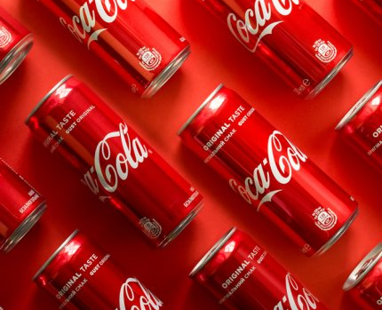
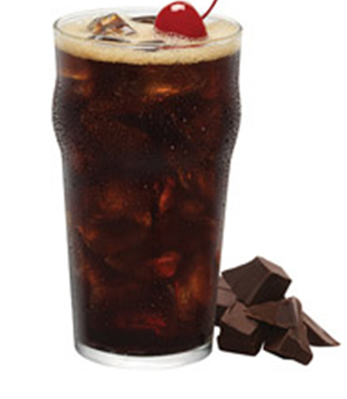
Why
Twitter is more effective for
communicating brand values
Maximize brand impact
Creatively express inclusivity
Align with other brands
to create premium content

Slide 9
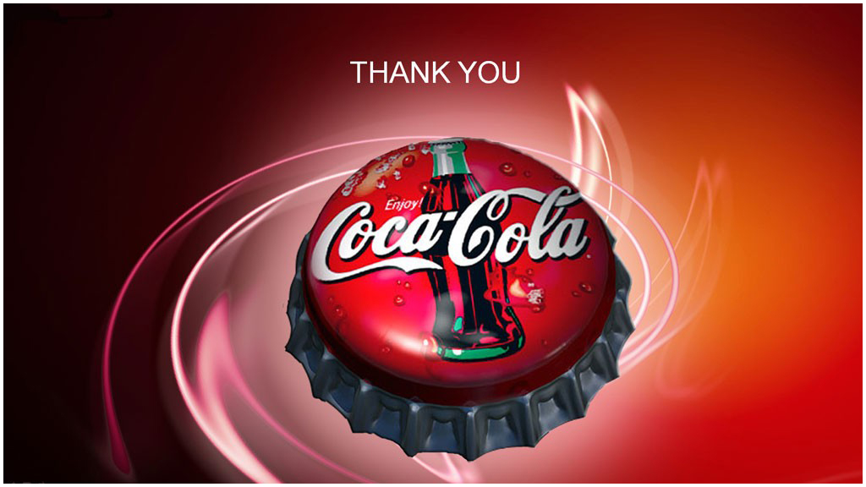

Slide 10
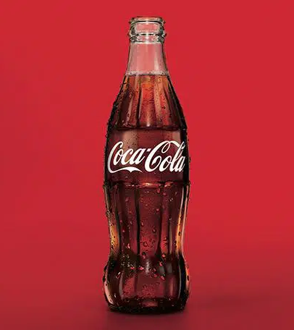
Market Research – John Buckingham
Graphic Design – Tobian Thompson
Creative Technical – Suzy Patnode
Technical Creative – Nick Ferguson

